Slide 1
PROJECT DOOR STEP
Mariner
Initial office visit- April 6, 2000
Discussed with Management - April 14, 2000
Follow-up office visit - May 30, 2000
Report Issued- May 31, 2000
Confidential

Slide 2
Project Doorstep - Mariner
Review Highlights
Project Objective:
We performed an on-site review of processes, procedures and controls that support the marketing business activities for Mariner Energy, Inc., a merchant investment of Enron. Our procedures included interviews with key commercial and accounting personnel. We also performed a review of hedging transactions from deal execution through settlement.
Team Members: Office Personnel Interviewed:
Brenda Herod - Energy Operations Frank Pici - CFO
Vlady Gorny - RAC Greg Harless - VP Marketing
Jim Brown- Arthur Andersen Mike Wichterich - Controller
Rod Banks - Sr. Marketing Rep.
Julie McGowen - Marketing Supervisor

Slide 3
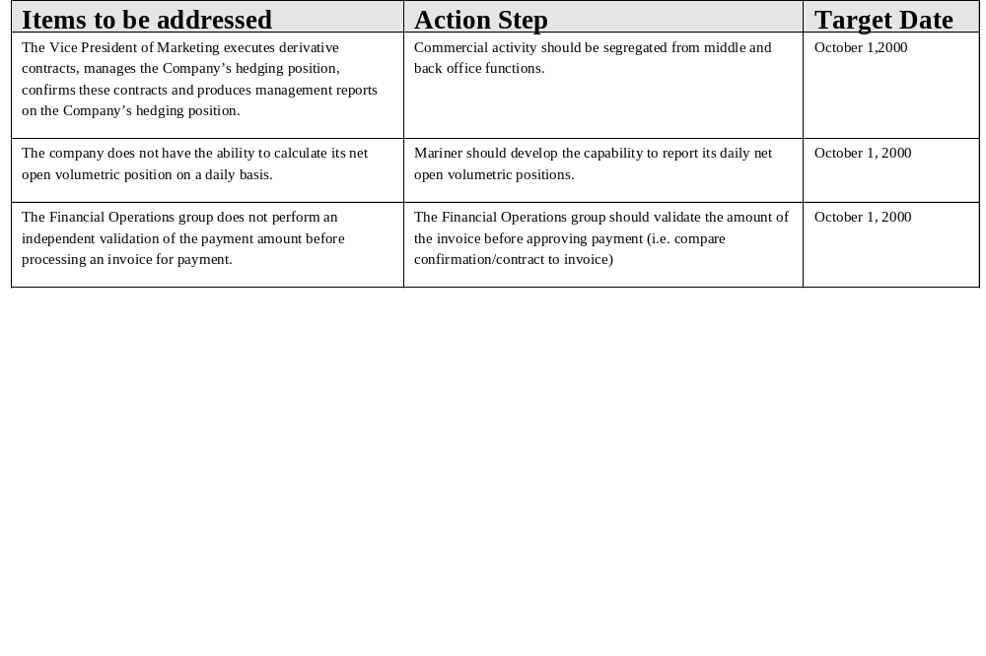
Project Doorstep - Mariner Observations

